Slide 1
NMotion A Continuous Integration System for NASA Software http://www.nasa.gov/centers/ivv/JSTAR/ITC.html
Justin McCarty
NASA IV&V Program
Justin.McCarty@tmctechnologies.com
NASA IV&V Facility
100 University Drive
Fairmont, WV 26554

Slide 2
Agenda
ITC Background
Motivation
Implementation
Challenges
Going Forward
Conclusion

Slide 3
ITC Background

Slide 4
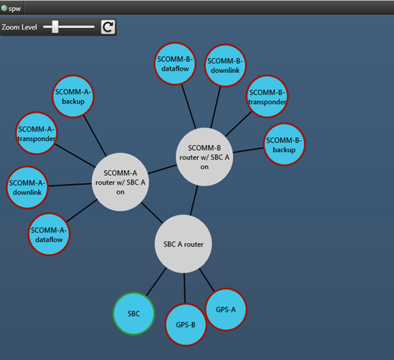
Independent Test Capability (ITC)
ITC Develops System Simulators
Experts in Hardware Modeling and Distributed Simulation
Experts in Simulator & Software Integration
NOS Architecture
Reusable Hardware Models
Custom Middleware
System Test Automation
Typical NOS Users
V&V Engineers
Project Developers
Operators and Testers

Slide 5
Mission Support
Past Support
Juno
Automated Flight Safety System (AFSS)
Global Precipitation Measurement (GPM)
Current Support
Deep Space Climate Observatory (DSCOVR)
James Webb Space Telescope (JWST)

Slide 6
Motivation

Slide 7
Motivations
Simulation Verification
Developers can focus on Development
System tests can take a long time
Test processes are repetitive
Tests are executed more often
Better Testing means Better Software
Significant overlap between projects
Testers can focus on tests

Slide 8
Test Complexity Example
SSRM Test Script
Verifies all testable requirements
Very complex, over 8000 lines
282 Commands
Over 36 unique commands
106 number of suspends
382 waits (without loops)
10902 seconds of wait (over 3 hours!)
Test log shows test requires over 8 hours of human testing time
As developed, the test builds upon itself
Difficult to split and run in parallel

Slide 9
Implementation

Slide 10
Implementation
JWST Integrated Simulation and Test (JIST) used as the prototype
Developed with Java and C/C++
Automated unit level tests for developed components
Three Phase Test Processing
System Adaptation
Test Execution
Result Analysis
Cloud Based Deployment
No end user code required

Slide 11
Basic Layout
User Test File
Test Logs
NOS Middleware
Operational Ground System
Automated Test Conductor
Command Processor
Instruction Set Simulator
Command Processor

Slide 12
Command Processor
Conductor I/O Control
Processor Logic
API 1
API 2
API 3

Slide 13
Data Flow
User
Test Conductor
Command Processor
Test to Run
Start Commands
Setup/Start Commands
Application Status
Application Logs
Test Results
Test Logs

Slide 14
System Adaptation
Preprocessing of existing test scripts
Remove Automation Deterrents (Automated)
User acknowledgement
Convert Raw Commands
Ensure all required files are found
Ensure results can be processed
Ensure all components can be interacted with remotely
Start/Stop of process
Command injection if required

Slide 15
Execution and Processing
Test scripts run are the same as system developers and operators
The system is reset in between each test
Test conductor ensures applications are brought up in any required order
Users provide a list of test cases to execute to the conductor
Application health is monitored
Test logs are collected from all applications
Test logs are parsed for any failures

Slide 16
Challenges

Slide 17
Challenges
Culture
Tests must be developed with automation in mind
Developers and testers are primarily only concerned with their environment
Lack of reuse between missions
Project Infrastructure and tools are not always developed with automation or remote interaction in mind

Slide 18
Going Forward

Slide 19
Going Forward
Integrate the autonomous system test execution into our continuous build server
Allow users to inject faults to test off nominal scenarios
Code refinement
Integration into other simulations
Support the scripting of environment setup
Integrate earlier into the development process

Slide 20
Conclusions
Enables higher level of automated testing (System)
Provides more testing (tests are more often)
Plan expand the system to other simulations
Plugin Based Operation
Who Benefits
Testers
Simulation Developers
Project Developers
If tools and tests are developed with automation in mind, new project adaptations become faster.

Slide 21
Contact Information
Web Page
http://www.nasa.gov/centers/ivv/jstar/JSTAR.html
E-Mail
Justin.R.Morris@nasa.gov
Team Mailing List: ivv-itc@lists.nasa.gov

